Slide 1
Columbus Community
Sports Park

Slide 2
Columbus Community Sports Park
Overview — Purpose & Need
  Create park and recreation space around the Historic Crew Stadium and adjacent to the Ohio State Fairgrounds
  Benefit neighborhoods, the City and the region

Slide 3
Columbus Community Sports Park
Geography
Near-northeast side of Columbus, along Interstate 71, between East 17th Avenue and Hudson Street

Slide 4
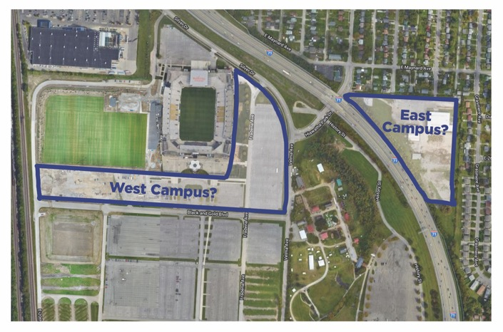
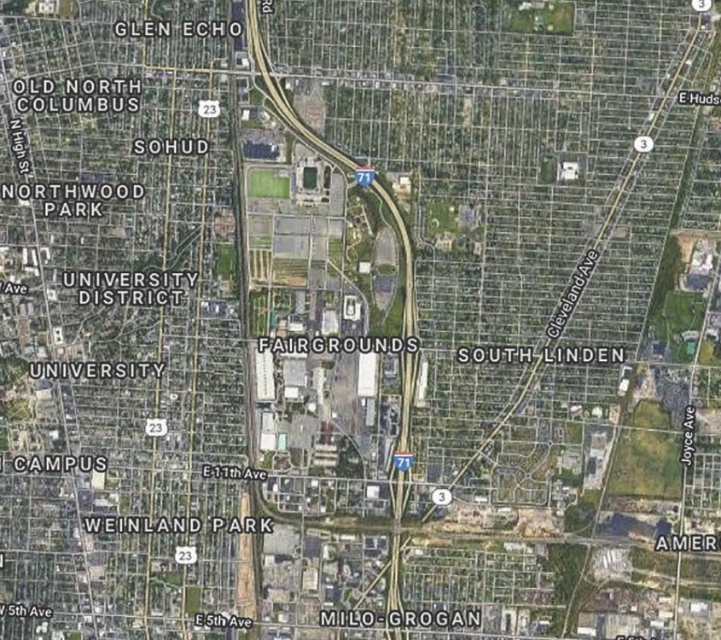
Columbus Community Sports Park
Geography —
25 acres
  “West” campus –
  17 acres
  “East” campus –
  8 acres

Slide 5
Columbus Community Sports Park
Benefits
Neighborhoods
  Once-in-a-lifetime opportunity to shape new green space, park space and recreational programming
  200,000 residents live within three miles of the site
  Milo Grogan, Weiland Park, Linden, North Columbus, Glen Echo, Indianola Trace, University District, Clintonville and others

Slide 6
Columbus Community Sports Park
Benefits
The City — Serve as a facility for youth and adult sports and provide more spaces for city-wide sports and recreational programming

Slide 7
Columbus Community Sports Park
Benefits
The Region — Create a first-in-class, tournament-grade sports and recreation facility to grow Columbus as a destination for regional and state tournaments and events
Boosts spending on local hotels, restaurants and other attractions

Slide 8
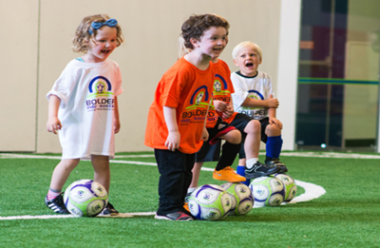
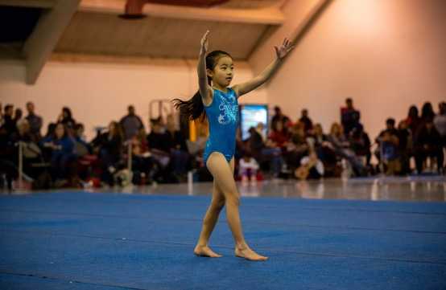
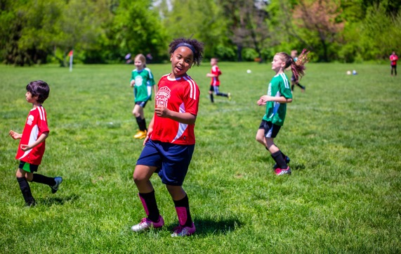
2 Primary Components
Organized – formal - sports programs
Informal sports and community park space

Slide 9
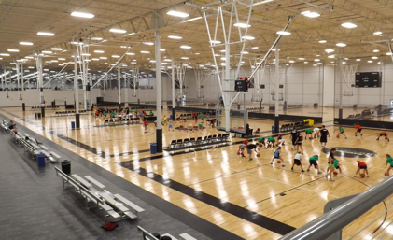
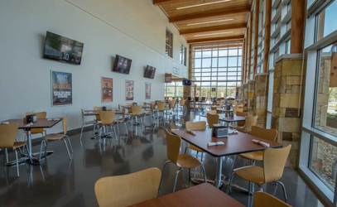
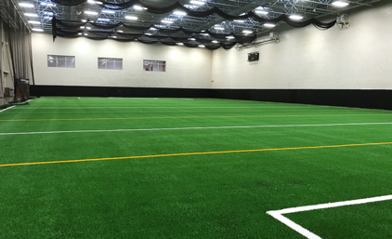
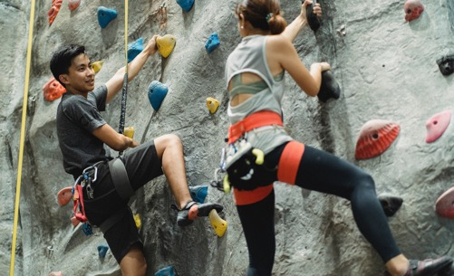
Organized Sports Program Spaces –
COULD Include
Multi-use wood courts
Indoor field space
Meeting rooms, classrooms
Rock climbing wall

Slide 10
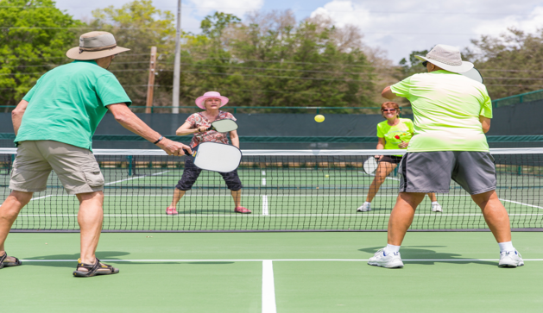
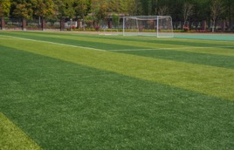
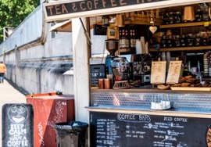
Organized Sports Program Spaces –
COULD Include
Outdoor, covered pickleball courts
Concessions area
Tournament-level synthetic turf field(s)

Slide 11
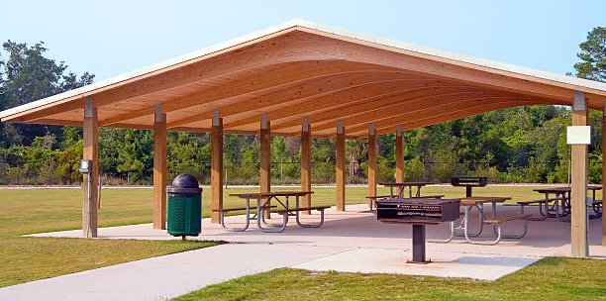
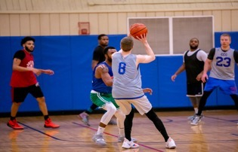
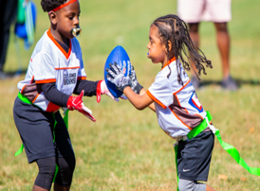
Informal Sports and Community Park Spaces – COULD Include
Mixed-use grass field(s)
Basketball courts
Additional green space – outdoor courtyard, open shelters and picnic tables

Slide 12
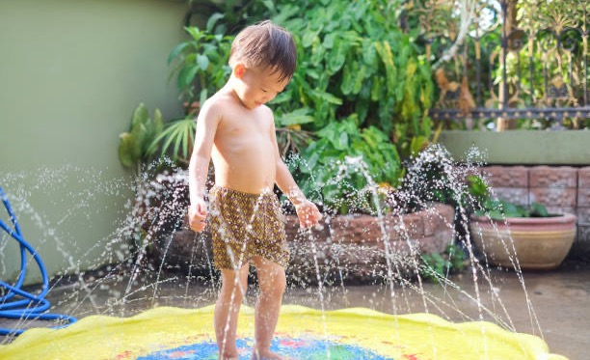

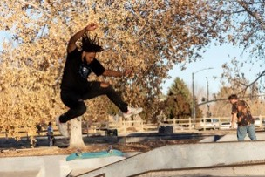
Informal Sports and Community Park Spaces – COULD Include
Walking and bicycling trails, with exercise stations
Playground and/or splash pad
Skate park

Slide 13
Stakeholder Feedback
Outreach and Engagement: Presentations
Commissions, civic association
Faith leaders
Area non-profits

Slide 14
Community Feedback on Project Options
Survey to Residents, Promote via:
CRPD Sports and CRP social media
CRPD Sports and CRP emails
CRPD Sports website
Earned media
Shared materials – presentation groups

Slide 15
Columbus Community Sports Park
Initial Key Dates
Community outreach, engagement meetings: May-June
Survey open for at least 30 days
Report back on survey results and next steps in summer
Sports Park construction process will be 18-24 months

Slide 16
Columbus Community Sports Park
Questions?

Slide 17
Columbus Community Sports Park
Next Steps
Take the survey: http://bit.ly/ccspsurvey21
Get updates (LIVE SOON): crpdsports.org/communitysportspark

Slide 18
Columbus Community Sports Park
Thank you!

