Slide 2
Welcome & Introductions

Slide 3
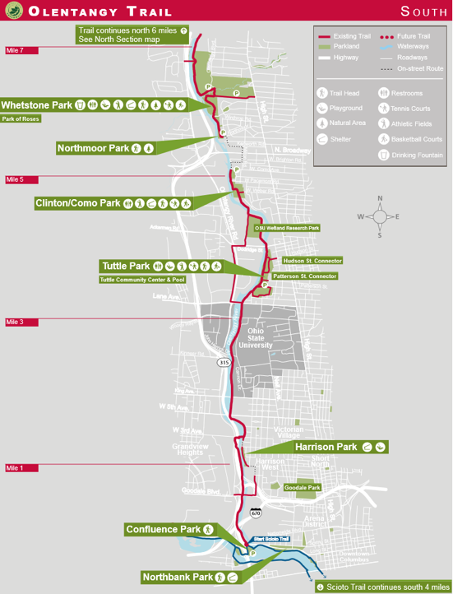

Slide 5
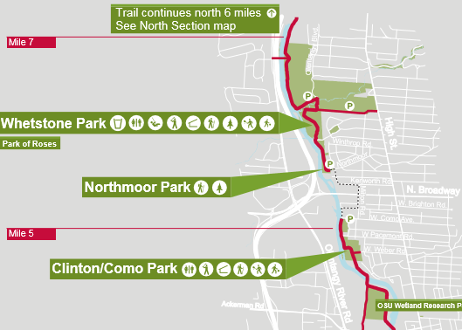

Slide 7
Timeline

Slide 8
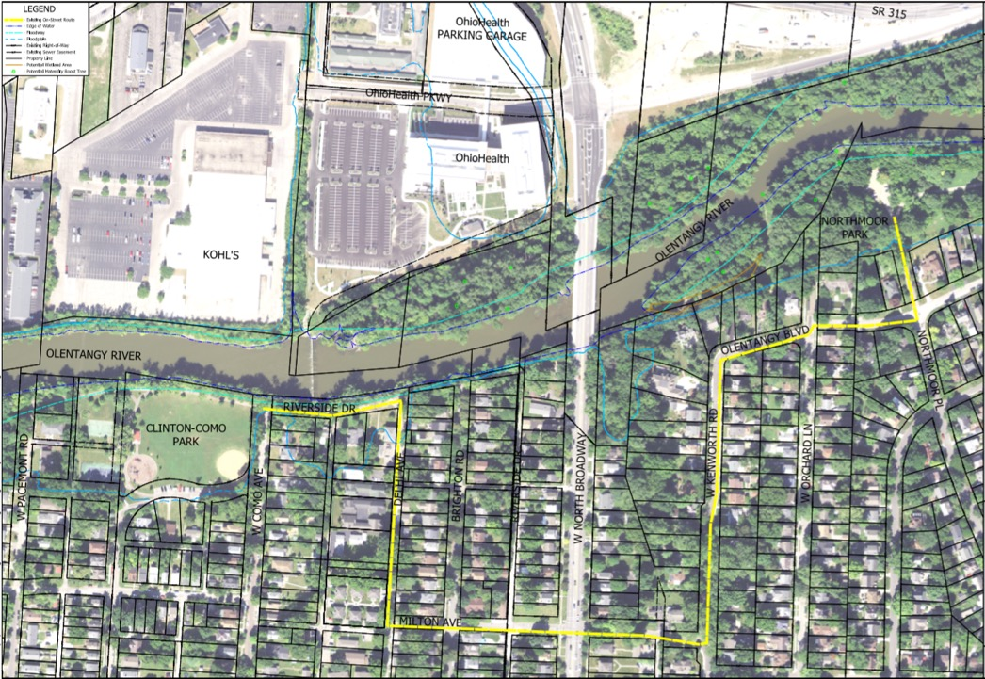
N

Slide 9
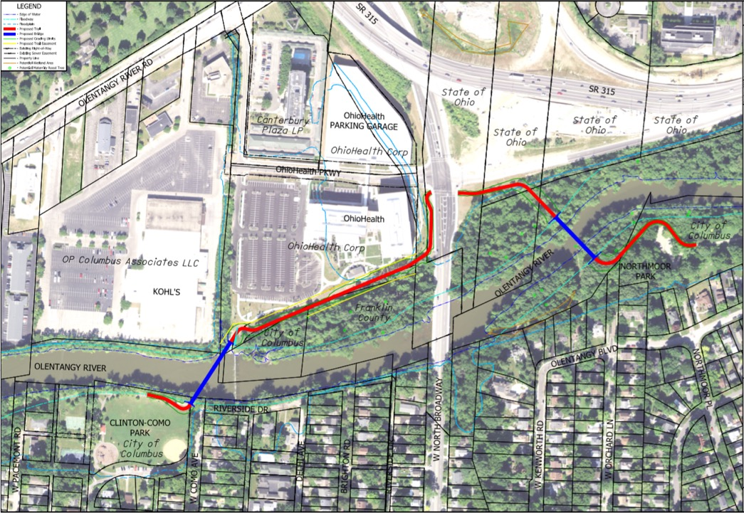
N
Alternative 1

Slide 10
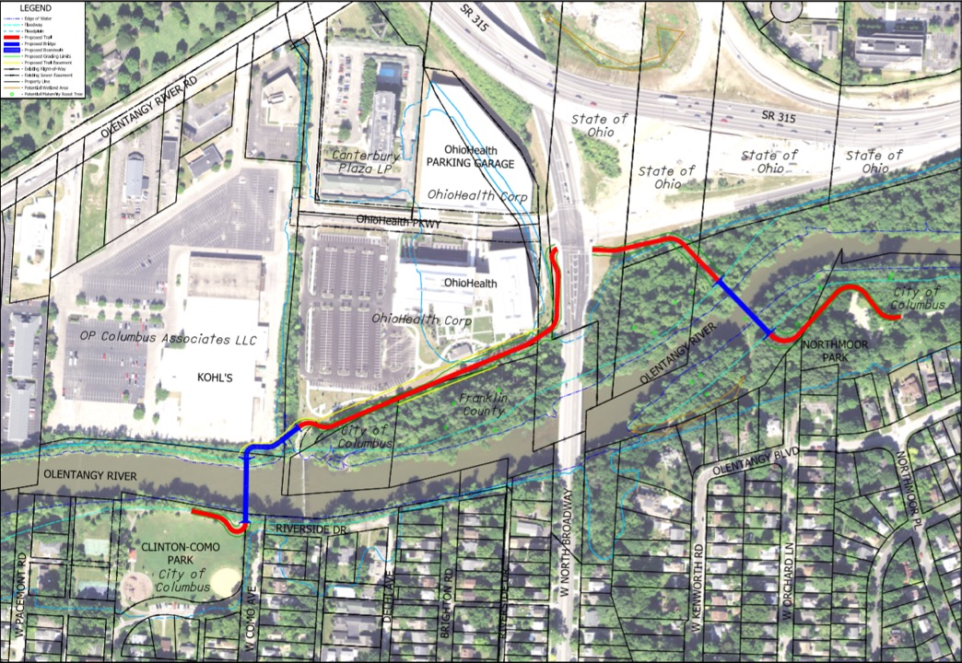
N
Alternative 2

Slide 11
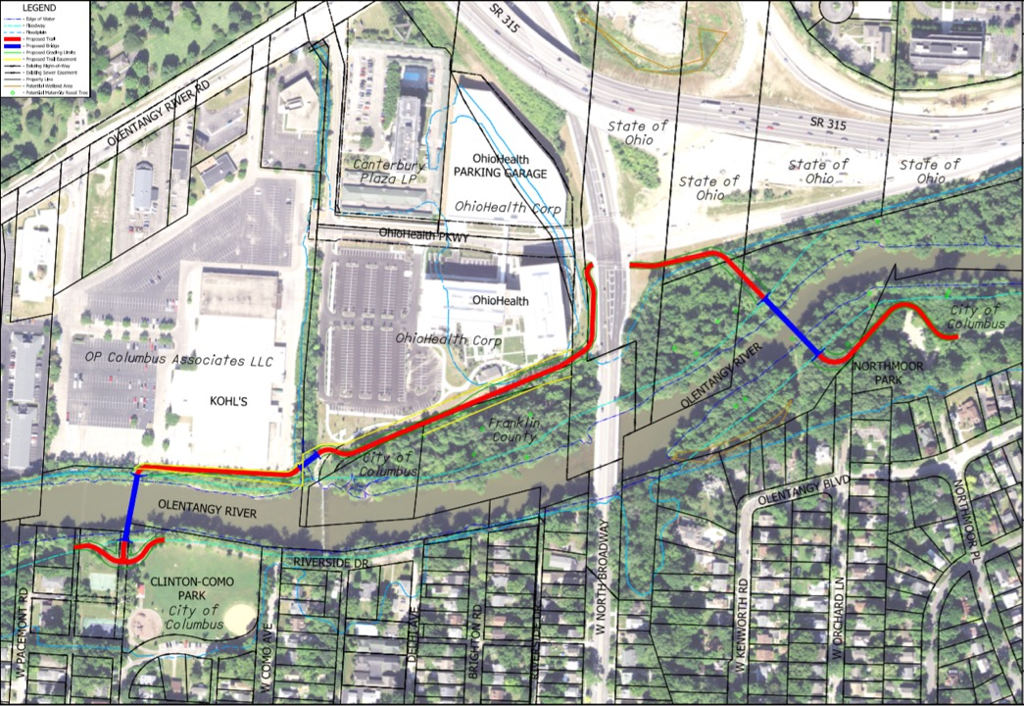
N
Alternative 3

Slide 12
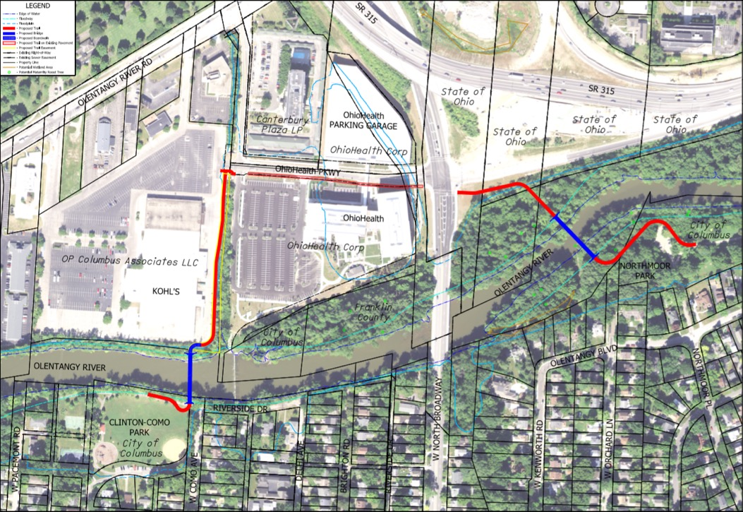
N
Conflict with pedestrians between garage and office building
Alternative 4

Slide 13
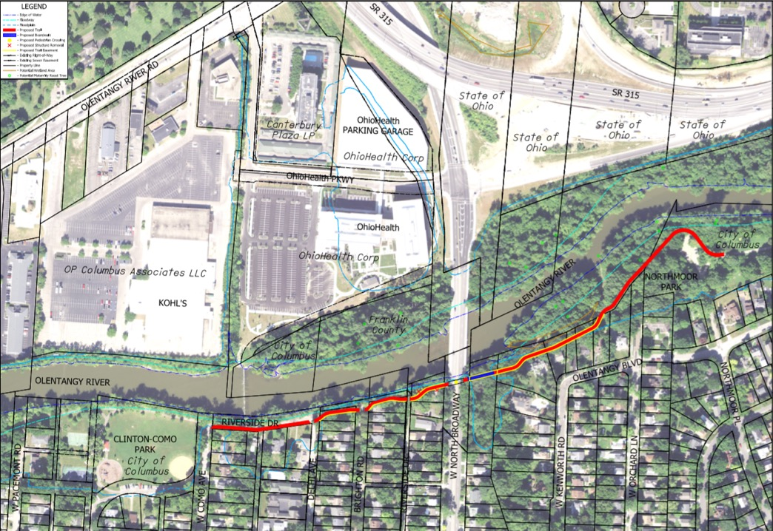
N
x
Residential Structure Removal
Mid-Block Crossing
Alternative 5

Slide 14
Next Steps
Meet with stakeholders
Hold a public meeting
Digest all input and make adjustments

Slide 15
Questions?

